Slide 1
Author: Alessandro Ferro
ICTIWEB501
Task 2
Student ID: 83126277

Slide 2

Down Hill Down Under
Introduction
Down Hill Down Under is a company specialized in selling bicycles for the practice of Down Hill Mountain Biking.
The sport isn’t widely known in Australia due to the flat nature of most of the territory, but is rapidly growing in recent years, especially on the east coast and the neighboring ranges.
To take advantage of the new-found popularity of the discipline, Down Hill Down Under want to expand the reach of their business by developing and promoting their commerce through a website for the Australian market.

Slide 3
Business Requirements
Home Page
A gallery to promote products and services.
An area with news, updates and promotions.
About Us Page
Details about the company: who they are, what they do, company statement and so on.
Contact Us Page
Enquiry Form
Google Maps
Product Page
At least ten products per page.
Picture of the products with details
Shopping cart Page
View the products in the shopping cart
Checkout Page
Payment and payment info

Slide 4
Standards
Fast loading
The website should offer to visitors a seamless experience with minimal loading time. 2 seconds is to be considered the acceptable threshold
Server
The website will run on an apache server.
XAMPP will be used as development environment.
Database
The data will be stored in a ERD database.
The database will store information about the products, the users and the transactions
Ease of Navigation
Navigation kept to a minimum.
Focus on products with large images and clear calls to action.
Important information clearly displayed on screen.

Slide 5
Purpose and Functionality
The purpose of the Down Hill Down Under online shop Is promote their shop and their products to a larger audience.
To improve the user experience the visitors have also access to a search function to allow them to look for a specific product.
The website will provide the users with a form to fill to make enquiries to Down Hill Down Under.
An interactive map will show where the shop is located.
The product page will be populated from a database, therefore requiring database connectivity.
The website will allow the users to add products to the shopping cart
The website will allow the users to purchase products online.

Slide 6
UI Requirements
Company Name
Should be immediately visible at the top of each page.
Cross-Browser Compatibility
The website should render properly and consistently in all the most common browsers.
Operative System
Aside from local font rendering and Native UI elements, the website is expected to render consistently across all the major Operative Systems.
User actions
All the actions the user can perform will be clearly positioned on the screen in accordance to the modern standards of UX and usability.
Design Principles
The layout of the website will be minimal, to draw the user attention to the products and their relevant information.
To keep things simple for the user, the website will not have more than three navigation levels

Slide 7
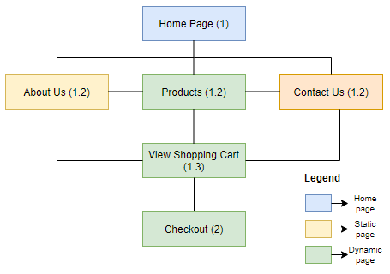
Website Navigation Map

Slide 8
Usability
The layout of the web pages should be simple.
The content of the web pages should be specific.
The focus on each web page should be on the actions the user can perform.
The website layout should adhere to the most familiar common practices.
Navigation depth should be kept to a minimum.
Links and navigation bars should be clear.
The web page should have a consistent look and feel.
Possible user actions per page should be kept to a minimum and should be highlighted in clear and descriptive terms.

Slide 9
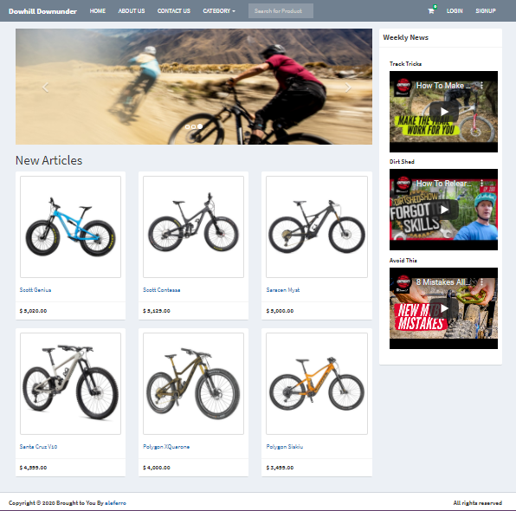
Prototype

Slide 10
Information Architecture
Each web page should be designed to fulfil a specific task.
The home page should display the most recent products.
The shopping cart should be accessible from every page
A search bar for products should be accessible from every page
About Us page should contain static content about the company
Contact Us page should show the company location on a map
Contact us page should contain a form to send a message to the company
Products page should display the product organized by catgories
Product Details page should allow to add the product to the shopping cart
Shopping cart icon should show a counter with the items in the shopping cart

Slide 11
Data Storage Requirements
The website relies on a database to store information relative to the users, the products and the transactions.
The data are mostly collected through forms submitted by the users, be it a new user registration or the checkout and payment process.
The website will use the MariaDB relational database.
The language used for the application on the server side is PHP.
SQL embedded in PHP is used to query the database.
Through the application, users will be allowed to update data relative to their profile in the database.
Storage in the Cloud could also be a viable option.

